Slide 1
High-throughput and Adaptive Feedback Microscopy
Christian Tischer, Sabine Reither, Volker Hilsenstein, Beate Neumann, Rainer Pepperkok
Advanced Light Microscopy Facility, EMBL Heidelberg
Meyerhofstr.1, 69117 Heidelberg, Germany
High-throughput microscopy of siRNA treated cells has become a standard tool for discovering genes with roles in specific biological processes. However, conducting high-throughput microscopy experiments is still challenging as it puts high demands on sample preparation, microscopy, image and data analysis. Moreover, further characterization of the “hit genes” often requires demanding microscopic assays that are difficult to perform even in medium throughput. In this talk, I will outline the typical challenges occurring in high-throughput microscopy and discuss how dedicated microscope systems can help to tackle these challenges. In addition, I will describe how “adaptive feedback microscopy” allows scientist to perform highly complex microscopic assays in a fully automated manner, thereby enabling detailed and systematic further investigation of the identified “hit genes”.

Slide 2
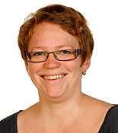
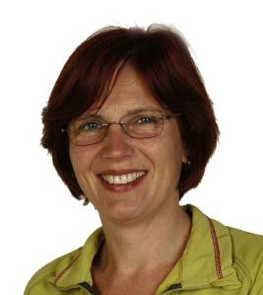
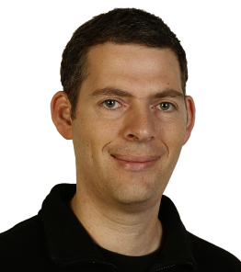
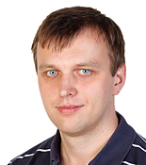
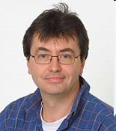
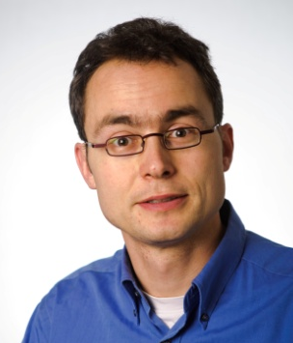
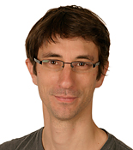
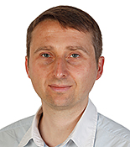
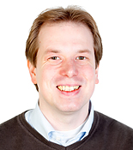
Advanced Light Microscopy Facility (ALMF) at EMBL Heidelberg, Germany
Since 1998 serving EMBL scientists and international visitors
High-Throughput Microscopy
Advanced Light Microscopy
Head of Facility
Sabine Reither
Beate Neumann
Stefan Terjung
Aliaksandr Halavatyi
Rainer Pepperkok
Volker Hilsenstein
Christian Tischer
Tobias Rasse
Marko Lampe

Slide 3

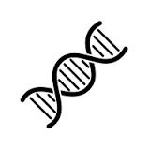



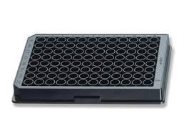
A ‘typical’ HT-microscopy screen
Biological process
Find novel genes
?
~40000 images
20x lens
2 channels
4 positions per well
Bioinformatic filter
~500 putative genes
Image analysis of
~4 million cells
~1500 siRNAs (3 per gene)
Statistics
~54 96-well plates (3 replicates)
List of “hit” genes
!

Slide 4

Microscope System Considerations
Invited by

Slide 5
Auto-focus Modalities
Pro:
Fast (<<1s)
Good for sample
Con:
Requires constant sample z-position
Requires presence of reflective surface
fixed offset
“Software” autofocus
Fluorescence z-stack imaging finding highest contrast plane
“Hardware” autofocus
Finding coverslip surface reflection using far-red light
Can be fast: <<1s
“Software” autofocus
Fluorescence z-stack imaging finding highest contrast plane
Typically (much) slower
Bleaching of the sample
Pro:
Can deal with samples at different z-positions
Con:
Slow (>>1s)
Not good for sample (bleaching)
Can get confused if objects are in multiple planes
Notes:
Pro:
Can deal with samples at different z-positions
Con:
Slow (>>1s)
Not good for sample (bleaching)
Can get confused if objects are in multiple planes
Pro:
Faster (<<1s)
Better for sample
Con:
Requires constant sample z-position
Requires presence of reflective surface

Slide 6



Multi-color Imaging Modalities
Halogen
lamp
LED
~ 0 s
Multi-band dichroic
Filter cube
>100 ms
Emission filter wheel >10 ms
Faster, no crosstalk
~100ms
~100ms
Simultaneous imaging for fastest speeds
$$
LED
~ 0 s
Multi-band dichroic
LED
~ 0 s
Multi-band dichroic
Crosstalk?!
Multi-band emission filter
Crosstalk?!
~100ms

Slide 7
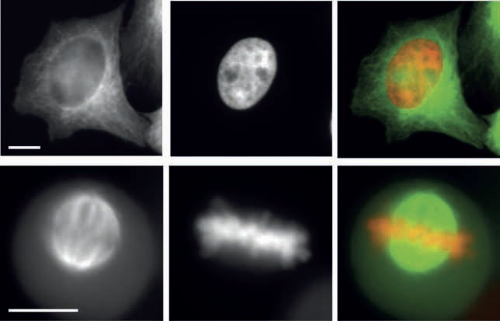
Sample mounting
GFP-Tubulin
Hb2-mCherry
Merge
Interphase
Plate bottom | Cell growth | Price | Imaging quality
Plastic | + | ~2 $ | o,+
Glass | o | ~10 $ | ++
Mitosis
Zeiss CellDiscoverer 7, 40x magnification, NA0.7
Imaged through 1mm plastic bottom

Slide 8
Multi-well Transmission Imaging
Brightfield contrast
Condenser lens
“Phase gradient contrast”
!
!
Zeiss CellDiscoverer 7, 5x magnification

Slide 9

Imaging Modality Considerations

Slide 10
Confocal stacks
10 um
z
Point scanning confocal
Spinning disc confocal
Quite fast (>1s per stack)
but 3-D data
and 3-D analysis
on-the-fly sum projection
10x less data, simpler 2D analysis

Slide 11
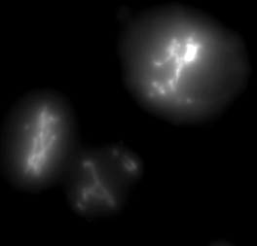
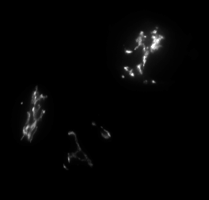
Widefield stack
Zeiss CellDiscoverer 7 Golgi-GFP, cropped image
Sum projection
z-stack, dz=1 um
Widefield NA0.9
Sum projection after deconvolution
10 um

Slide 12
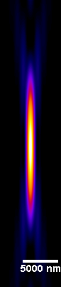
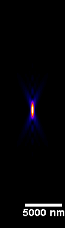
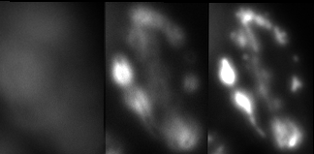
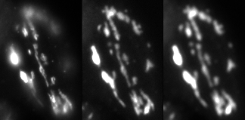
Wide-field single plane with low NA lens
NA 0.3
NA 0.9
Zeiss CellDiscoverer 7 (adaptable NA)
Hela cell, Golgi-GFP
z-stack
1um steps
z
Central plane
Widefield NA0.3
Whole cell in focus in one single image
NA 0.8
80 ms
30% light
NA 0.35
150 ms
40% light
NA 0.26
380 ms
80% light

Slide 13
Image analysis, quality control and statistics

Slide 14
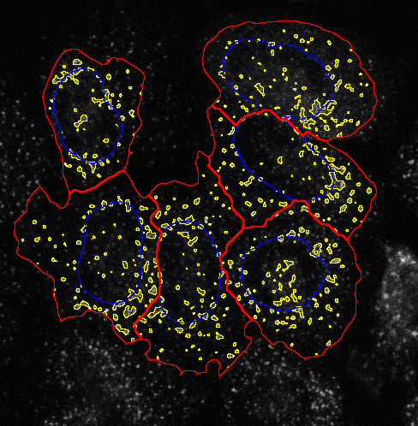
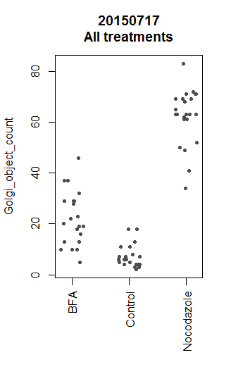
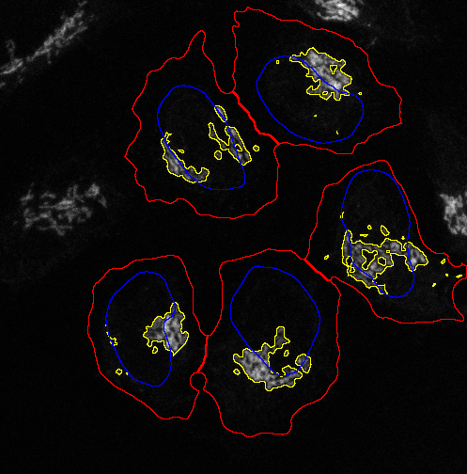
Image analysis, Visual inspection and Statistics
Integrated solution from one company
Gene
Hit
List
Image analysis
Visual inspection
Statistics
Very little IT hassle
Turn-key solutions for some standard assays
+
+
+

Slide 15

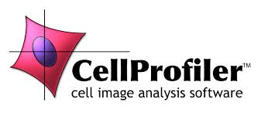

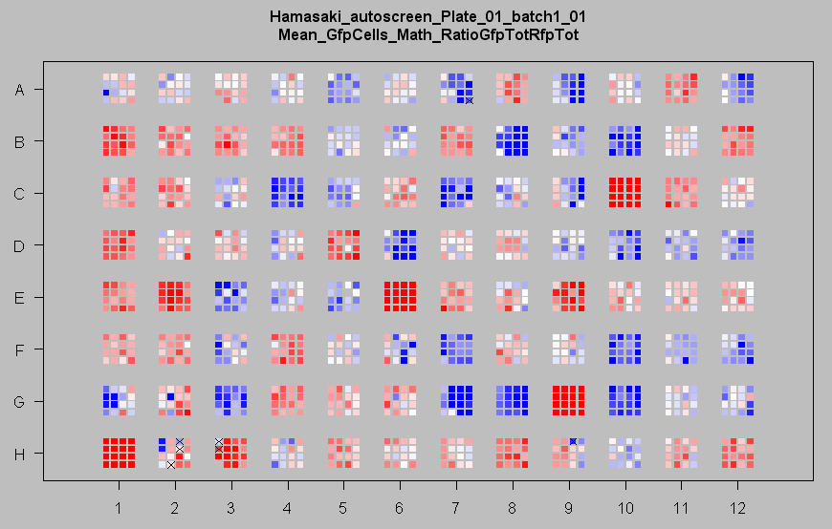
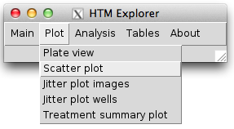
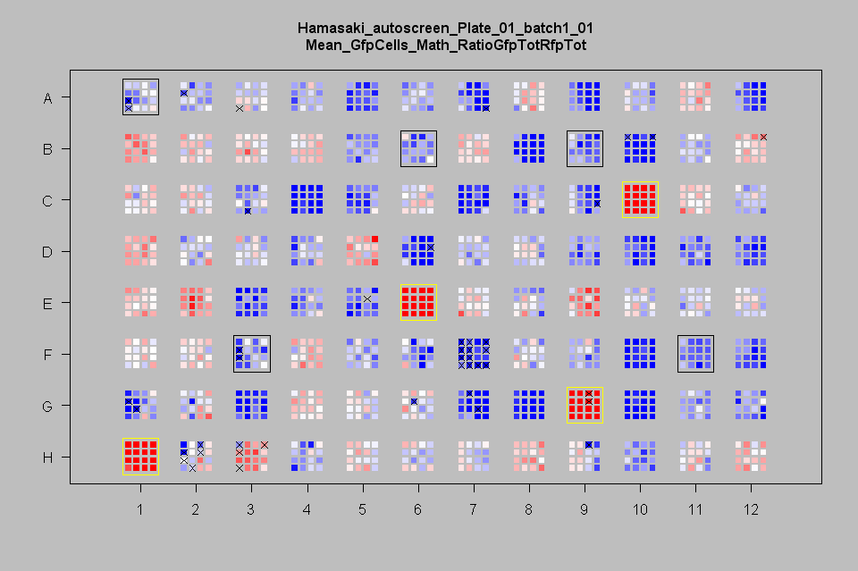

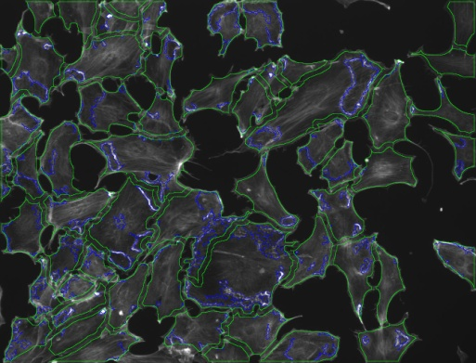
Image analysis, Visual inspection and Statistics
Different
companies
Tiff images with defined naming scheme (“raw data”)
20000 image sets
=> 1000 parallel jobs
20 image sets per job
<1h total analysis time
File conversion and renaming
Linux Compute Cluster
Segmentation images
+ Table (txt file)
+
Gene
Hit
List
+
+
Simple Laptop
‘HTM-Explorer’ R and ImageJ
Carpenter et al, (2006) CellProfiler: image analysis software for identifying and quantifying cell phenotypes. Genome Biology 7

Slide 16

List of interesting genes … and now?
Most interesting gene => PhD project
Bio-informatic network analysis
High-content ‘secondary’ screens
High-resolution time-lapse
Fluorescence recovery after photo-bleaching (FRAP)
Fluorescence cross correlation spectroscopy (FCS)
Systematically performing such high-content experiments often strongly benefits from “Adaptive Feedback Microscopy”

Slide 17
Adaptive Feedback Microscopy Intelligent Microscopy Smart Microscopy Open Application Development (OAD) [Zeiss]
Todo:
add references
Look for more synonyms
Adapted settings
Analyze data
Conrad et al., Nature Methods (2011)
Tischer et al., Methods Cell Biol. (2014)
Scherf & Huisken, Nature Biotechnology (2015)

Slide 18
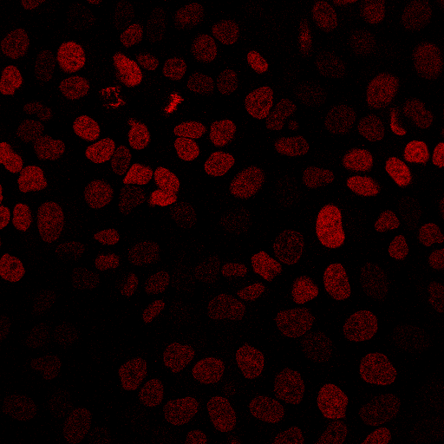
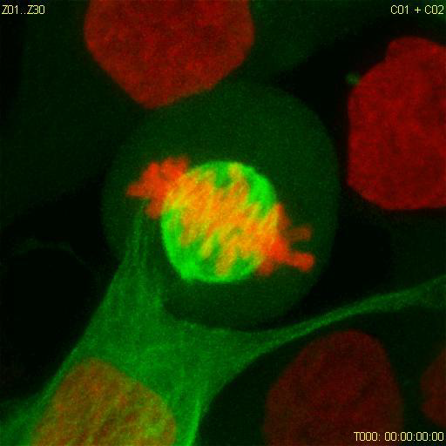
Adaptive Feedback for High-resolution Time-lapse Imaging
Move to pre-defined position
Acquire low-res image
H2B-mCherry (DNA)
single plane
Find mitotic cell by automated analysis
x, y
x=150 y=80
Zoom in on target object
Acquire high-content data
Conrad et al., Nature Methods (2011)

Slide 19
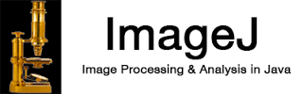
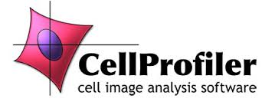

Zeiss ZEN Blue (e.g., LSM 800, CellDiscoverer 7)
Python Programming Interface
Zen Blue Image Analysis Modules
Todo:
add references
Look for more synonyms
ImageJ
CellProfiler
CellCognition

Slide 20
Zeiss AIM (LSM 510)
Zeiss ZEN Black (e.g., LSM 780, LSM 880)
Visual Basic Programming Interface
Custom written visual basic
“Pipeline constructor” [1]
(Antonio Politi, Jan Ellenberg)
Todo:
add references
Look for more synonyms
ImageJ
CellProfiler
CellCognition
[1] Rabut and Ellenberg, Automatic real-time three-dimensional cell tracking by fluorescence microscopy. J. Microscopy, 2004

Slide 21
Automated FRAP Microscopy on ER Exit Sites
Aliaksandr Halavatyi
Move to next grid position
Zeiss LSM780
Visual Basic
ImageJ
Tischer et al., Adaptive Feedback Microscopy (2014) Methods in Cell Biology
Halavatyi et al., High-throughput Microscopy (2016) GIT Imaging and Microscopy

Slide 22
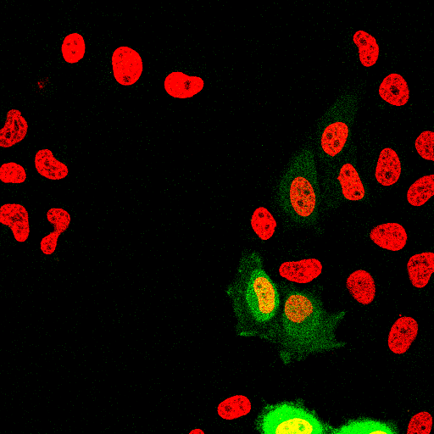
Automated FCCS screening of chromatin interaction of EYFP-tagged proteins, using Histone H2B-mCherry as a chromatin marker.
Move to next grid position
For each coordinate: acquire 30s FCCS
Leica confocal
Zeiss confocal
I(t)
t
Leica CAM Visual Basic
Tested 53 proteins for chromatin interaction [1].
=> For each protein:
~ 1100 FCS measurements
in 189 cells
Micropilot
ImageJ/Fiji
[1] Wachsmuth et al., High-throughput microscopy fluorescence correlation spectroscopy… (2014) Nature Biotechnology
[2] Conrad et al., MicroPilot: Automation of fluorescence microscopy … (2011) Nature Methods

Slide 23
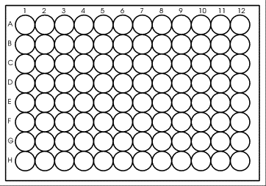
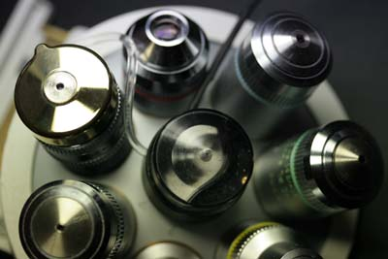
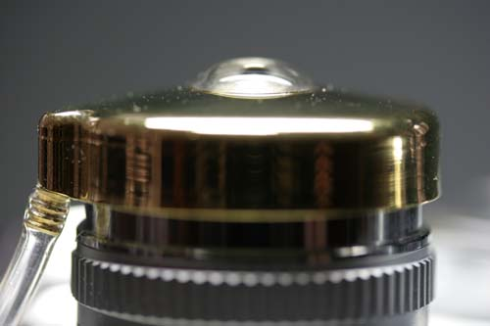
FRAP and FCS => high resolution => high NA => immersion lenses
96-well imaging plate
Automated immersion
(oil and water)
~ 13 cm

Slide 24


















Current Industrial Partners (in alphabetical order)

Slide 25
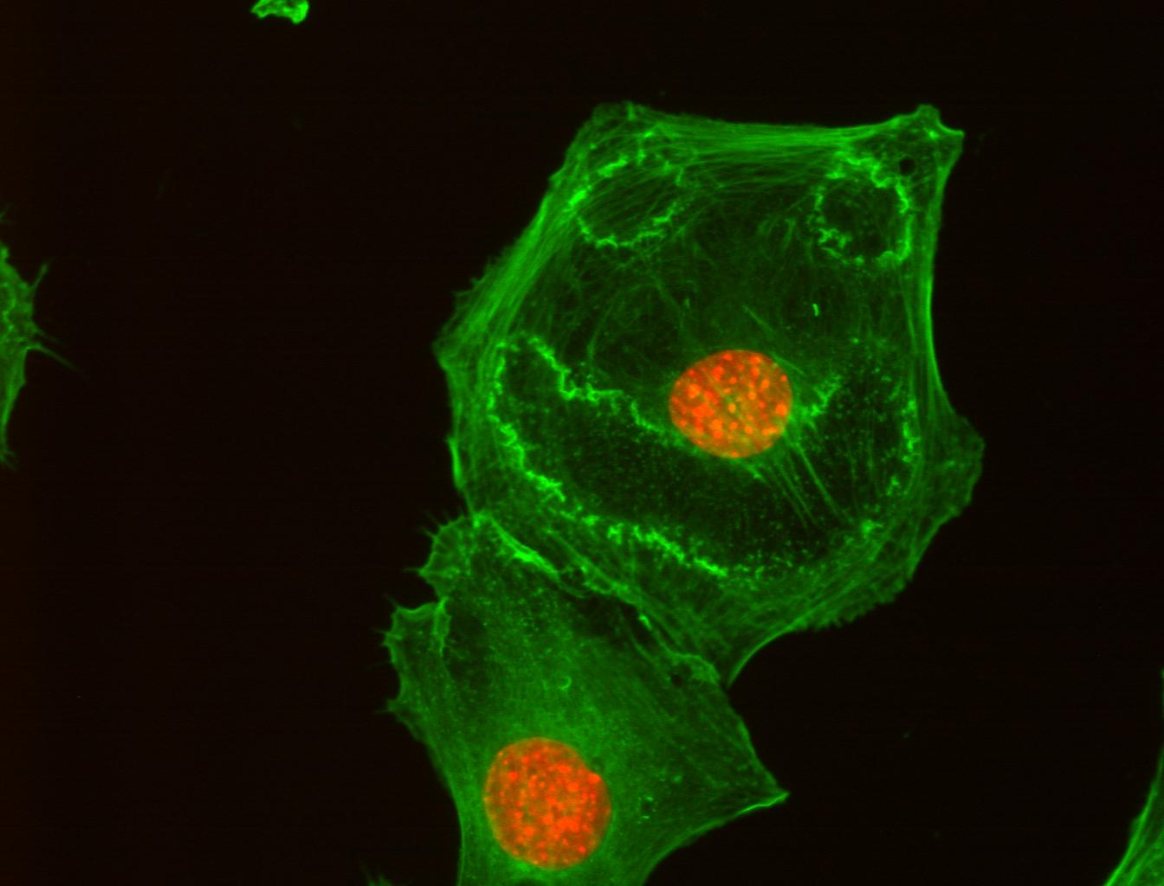
Thank you for your attention!
Thanks to Zeiss for the invitation!
Acknowledgements
ALMF team:
Beate Neumann
Sabine Reither
Volker Hilsenstein
Aliaksandr Halavatyi
Tobias Rassse
Stefan Terjung
Rainer Pepperkok
Ellenberg Team:
Antonio Politi
Jan Ellenberg
Green: actin cytoskeleton
Red: nucleus
Cells treated with PDGF

Slide 26
Additional slides, kicked out to stay in time

Slide 27
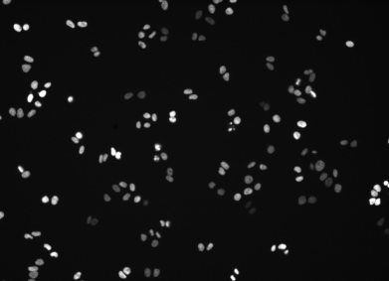
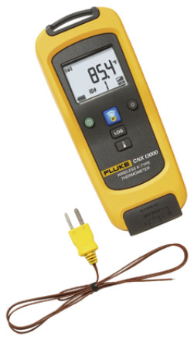
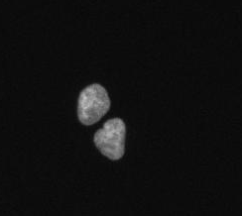
Environmental control
Zeiss CellDiscoverer 7, H2B-mCherry
10x every 30min, 48h
37C ?!
37C ?!
37C ?!
38C => visible mitotic defects
(e.g., increased mitotic index and micro-nuclei formation)
Cropped and enlarged view on above movie

Slide 28
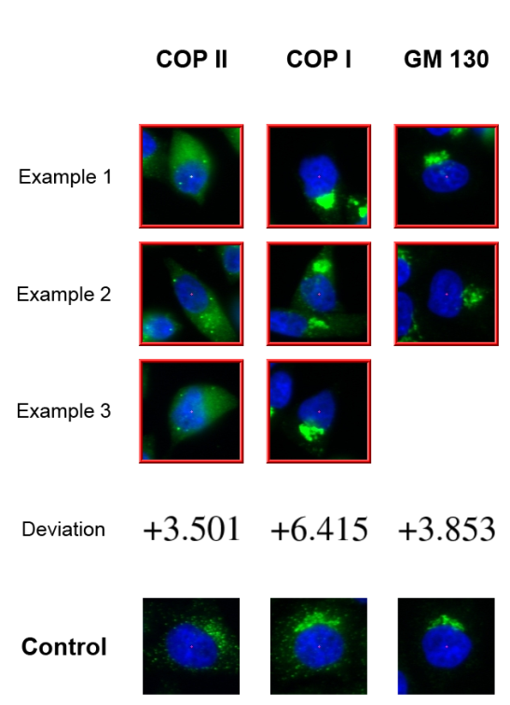
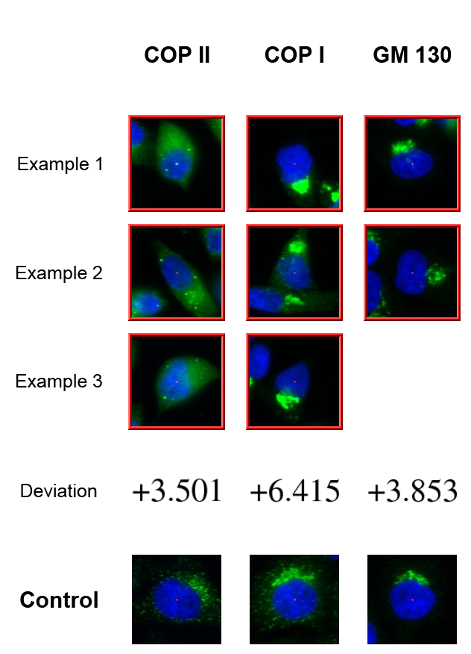
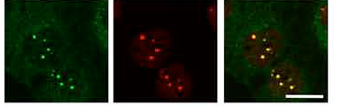
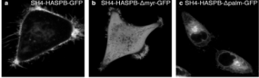
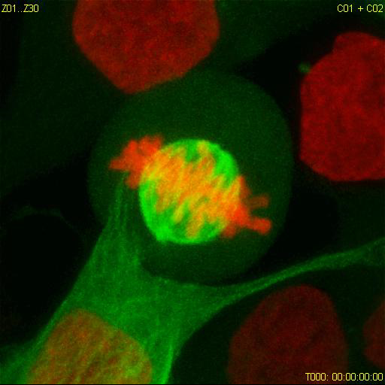
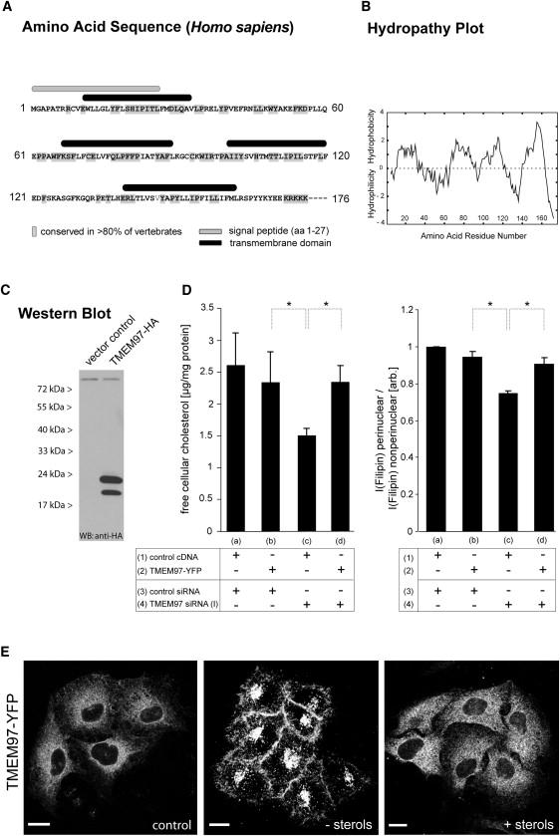
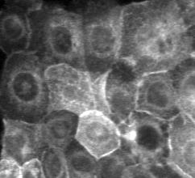
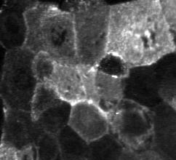
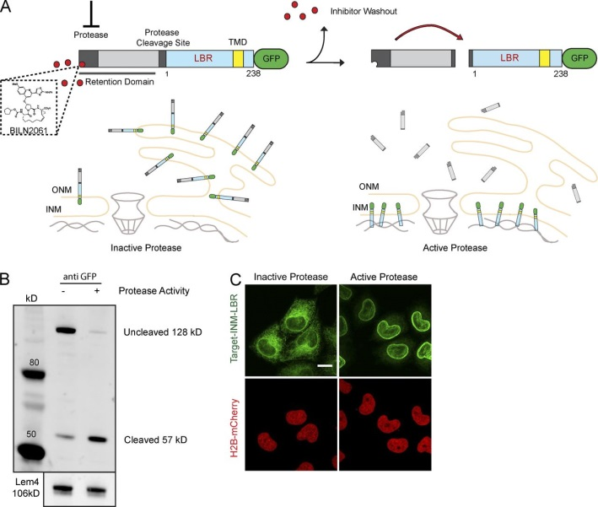
Completed HT-microscopy projects with ALMF support
Protein secretion / membrane
trafficking / organelle organisation
Simpson et al., Nat Cell Biol. 2012
DNA repair
Gudjonsson et al., Cell 2012
Lukas et al., Nat Cell Biol. 2011
Doyle et al., Cell. 2009
Plasma membrane targeting
Ritzerfeld et al., Genome Research 2011
Cell division
Neumann et al., Nature 2010
Cholesterol metabolism
Bartz et al, Cell Metab. 2009
Blattmann et al., PloS Genet 2013
Cystic Fibrosis
Almaca et al., Cell 2013
Inner membrane nuclear targeting
Boni et al. J Cell Biol 2015
Notes:
RNAi microarrays are Here you can see the summary of projects using RNAi microarrays.
All projects labelled in red were genome-wide screens.
These RNAi microarrays can be used for many different assays types as shown here.

